Slide 1
Networking
CITS5503, Week 7
Dr Anwarul Patwary
1
Notes:
Clearly I am not Dr Anwarul.
1

Slide 2
Networking
CITS5503, Week 6
Brett Looney
Principal Solutions Architect
Amazon Web Services
2
Notes:
Clearly I am not Dr Anwarul. My name is Brett and I’m a Solutions Architect with Amazon Web Services. I’ve been with AWS for seven years working here in Perth with West Australian customers and customers across Australia and around the world. I’m a networking nerd by trade so I’m clearly here for the right topic; but I’ve left some time at the end of the session so that you can ask other general AWS questions as well.
2

Slide 3
Agenda
Networking fundamentals
Network isolation through Network Address Translation
Load Balancing
Notes:
This is my task for today: to talk to a bunch of networking things that you need to know and not bore you to death. Luckily for you, I think networking is really cool and it is a fundamental building block of anything done in technology. Unluckily for you I can talk about this topic for weeks. So again, I’ll try not to bore you with things.

Slide 4

Networking
Notes:
So let’s talk about networking…

Slide 5
Networking
Creating cloud resources requires some knowledge of networks
Major focus is on TCP/IP (UDP not so much) as this is the basis for HTTP(S)/TLS
Focus on IPv4 addressing rather than IPv6 as the latter still not significantly supported (in Australia)
Need a basic understanding of concepts like:
Routing
Private and public networks
Network latency and throughput
Notes:
What do you need to know.
[Click] First, if you don’t have a network then nothing works. This is true anywhere, not just in cloud. AWS has gone a long way to make sure that you have the networking services that you need and that they are (for the most part) easy to set up and configure.
[Click] It’s really important that you understand the basics of how IP works. It’s not called Internet Protocol for nothing; it was designed to make the Internet work. There are many other protocols that use IP; TCP (Transmission Control Protocol) and UDP (User Datagram Protocol) are the two most well-known ones. We’ll be concentrating on TCP because it is used by things like HTTP and HTTPS as an underlying transport. UDP is simpler and is used by things like DNS.
[Click] We’re going to talk mostly about IPv4. This is lucky for you too because IPv4 has a shorter address space than IPv6 so it’s easier as an introduction. IPv6 adoption globally still isn’t fantastic; but if you understand IPv4 the major difference is that the addresses are much longer – 128 bits for IPv6 as compared to 32 bits for IPv4. So it’s not difficult to upgrade your knowledge later.
[Click] Finally, you do need to understand how IP is routed because if you don’t it’s really easy to look at a problem and blame the network. That’s not to say the network is 100% reliable – it never is – but if you can eliminate the network from your troubleshooting then your life is much easier. We also need to cover the differences between private and public networks and then something that trips many people up – how latency is related to bandwidth and throughput.

Slide 6
TCP/IP Addressing
IPv4 (where IP is used it implies IPv4) address is made up of 32 bits
Written in “dotted decimal” notation
nnn.nnn.nnn.nnn
130.95.172.57 (www.csse.uwa.edu.au)
Translation between name and IP address done by Domain Name System (DNS)
Specific ranges of IP addresses reserved as Private Addresses:
RFC1918 name | IP address range | Number of addresses | Largest CIDR block (subnet mask)
24-bit block | 10.0.0.0 – 10.255.255.255 | 16,777,216 | 10.0.0.0/8 (255.0.0.0)
20-bit block | 172.16.0.0 – 172.31.255.255 | 1,048,576 | 172.16.0.0/12 (255.240.0.0)
16-bit block | 192.168.0.0 – 192.168.255.255 | 65,536 | 192.168.0.0/16 (255.255.0.0)
Carrier-Grade NAT | 100.64.0.0 – 100.127.255.255 | 4,194,304 | 100.64.0.0/10 (255.192.0.0)
Notes:
[Click] You can safely assume for this entire presentation that when we refer to IP we’re talking IPv4. In IPv4 each address is 32 bits long.
[Click] The address is normally written in dotted decimal notation – four numbers, each between 0 and 255 inclusive, separated by a full stop
[Click] This IP address is the address for the server running the web server for the Department of Computer Science and Software Engineering here at UWA. If you haven’t seen an IP address before it’s just like a phone number but for a computer somewhere. And it’s mostly important that every computer have a unique IP address. If you had the same phone number as someone else that’d be bad, right? Same goes for IP addresses.
[Click] Now, people don’t tend to use IP addresses much because they’re difficult to remember. Instead we use names and the system responsible for getting the IP address from a name is called DNS. On it’s own, DNS is easily a several hour or maybe even several day topic but rest assured it’s a major part of how things work. If the network doesn’t work then nothing works. But if DNS isn’t working that pretty much everything doesn’t work anyway.
[Click] Finally – and this is more important for later – there are ranges of IP addresses which are called “private addresses”. There’s actually nothing special about them other than everyone agrees that these addresses can be used by you on your private network. You can choose to use the 192.168 range and so can someone else – but because they are private those two networks can’t communicate with each other across the Internet. Primarily because they’re the same address space but also because private networks can’t communicate with each other over the Internet. Now, I’m lying slightly but you’ll find out why when we talk abut Network Address Translation.

Slide 7
Networks, Hosts and Routers
To route an IP packet(路由一个IP包), you’ll need three (maybe four) things:
Your IP address
Destination IP address
Your subnet mask
Your local router
Process:
Use subnet mask to figure out your network and host address
Use subnet mask to figure out destination network and host address
If on same network, send packet directly(同一子网直接发)
If on different network, send packet to router(不同子网发给router)
Notes:
[Click] If you want to send a packet to me you’re going to need to know three things. Maybe a fourth – it depends.
[Click] First, you need to know your IP address. That should be pretty easy, right?
[Click] Next, you need the destination IP address that you’re sending to. That’s me. How do you know that? Well, if you’re using a web browser you’re typing in www.something and DNS will figure out the IP for you. But you can also just type in the IP address.
[Click] You also need to know your subnet mask. “What’s a subnet mask?” I hear you ask. More details in a moment but it’s a piece of information that tells you what network you’re on. Hold that thought.
[Click] Finally, you might need to know the IP address of your local router. A router is a device that connects networks together – it takes IP packets from one network and puts them on another. Anytime you’re crossing a network boundary you’re going to need a router.
[Click] So what’s the process then? First you take your subnet mask and you use it with your IP address to figure out what network you’re on; and it also tells you what host you are on that network. That’s not particularly important but it’s a byproduct of the process.
[Click] Next you take your subnet mask and use it with the destination IP address to figure out what network the destination is on. Note that the destination might have a different subnet mask to you but that’s totally fine. We don’t care what the destination thinks and there’s no reliable way to figure out what the destination subnet mask is so we don’t even ask.
[Click] Now what we have are two network addresses – one that is yours; and one that is the destination. If they’re the same we are on the same network and we can just communicate with each other.
[Click] But if they’re different then we need a router to help out – so we send the packet to the local router and let it deal with it.

Slide 8
Subnet Masks
Determines network and host address from the IP address
Usually written in “dotted decimal” notation
nnn.nnn.nn.nnn
e.g. 255.255.255.0
Easy example:
IP Address: 192.168.10.54
Subnet mask: 255.255.255.0
Network: 192.168.10
Host: 54
Notes:
So what is a subnet mask? [Click] It’s a little piece of information that lets you figure out from your IP address what network you’re on.
[Click] Just like an IP address it is 32 bits long and written in dotted decimal notation. That’s good for us humans but basically it comes down to representing the binary digits where a “one” means that the corresponding part of the IP address is the network; and a “zero” means that the corresponding part of the IP address it the host. Got that? Excellent.
[Click] Here’s an easy example.
[Click] Our IP address is 192.168.10.54. If you remember from earlier, this is a private IP address but subnet masks work for all addresses so no issues there.
[Click] Our subnet mask is 255.255.255.0. Turns out that 255 in decimal is ”all ones” in binary. So this subnet mask means that:
[Click] The first three octets of the IP address is the network, so we are on network 192.168.10.
[Click] And we’re host 54 on that network but that’s not important to anyone but us.

Slide 9

Subnet Masks
Another easy example:
IP Address: 15.23.98.201
Subnet mask: 255.0.0.0
Network: 15
Host: 23.98.201
Harder example:
IP Address: 143.88.103.35
Subnet mask: 255.255.240.0
Network: 143.88.96
Host: 7.35
Notes:
Let’s try another one. [Click] Our IP address is 15.23.98.201 and our subnet mask is 255.0.0.0. So what’s our network address?
[Click] Yup, this is network 15. Note that normally we’d write it as 15.0.0.0 but no biggie. And we are host 23.98.201 on this network. Note that the computer doesn’t read it the same way we do – it takes the three octets or bytes there and makes them into one big binary number. The way we do it it’s easier for humans.
[Click] Let’s do a harder one.
[Click] Our IP address is 143.88.103.35.
[Click] But our subnet mask is 255.255.240.0 – oh, what happened to the 255? Well, it turns out that 240 is a valid number for a subnet mask.
[Click] This means we are network 143.88.96 and [Click] We are host 7.35.
Is everyone following along? How did we get there? It’s ok. Let me show you how it works.

Slide 10
Subnet Masks – Let’s step through that
Address: 143.88.103.35
Subnet mask: 255.255.240.0
Network: 143.88.96
Host: 7.35
Address (decimal) | 143 | 88 | 103 | 35
Notes:
Let’s take that information – this is the same example – and break it down by showing you the decimal parts and the binary conversion that goes with it.

Slide 11
Subnet Masks – Let’s step through that
Address: 143.88.103.35
Subnet mask: 255.255.240.0
Network: 143.88.96
Host: 7.35
Address (decimal) | 143 | 88 | 103 | 35
Address (binary) | 1000 1111 | 0101 1000 | 0110 0111 | 0010 0011
Notes:
This is our IP address in binary. Clearly the decimal representation is easier for humans but computers like ones and zeroes so here we are.

Slide 12
Subnet Masks – Let’s step through that
Address: 143.88.103.35
Subnet mask: 255.255.240.0
Network: 143.88.96
Host: 7.35
Address (decimal) | 143 | 88 | 103 | 35
Address (binary) | 1000 1111 | 0101 1000 | 0110 0111 | 0010 0011
Subnet mask | 1111 1111 | 1111 1111 | 1111 0000 | 0000 0000
Notes:
This is our subnet mask in binary. Notice that it’s a nice string of ones followed by zeroes. The interesting part is that a 255 is all ones (that’s easy); but the 240 is four ones followed by four zeroes. This tells us that the first four bits of the “103” is the network; and the last four bits are the host. The last byte (8 bits) is also part of the host.

Slide 13
Subnet Masks – Let’s step through that
Address: 143.88.103.35
Subnet mask: 255.255.240.0
Network: 143.88.96
Host: 7.35
Address (decimal) | 143 | 88 | 103 | 35
Address (binary) | 1000 1111 | 0101 1000 | 0110 0111 | 0010 0011
Subnet mask | 1111 1111 | 1111 1111 | 1111 0000 | 0000 0000
Network (binary) | 1000 1111 | 0101 1000 | 0110 0000 | 0000 0000
Notes:
To get the network number what the computer does is do a bitwise AND between the address and the subnet mask. An AND operation is very efficient for computers. 1 AND 1 is still 1. 0 AND 1 is 0. 0 AND 0 is 0. So what happens is that the network component stays the same but the host component gets turned into zeros because the subnet mask is a zero for the last 12 bits of the subnet mask.
Now this is still in binary so not easy for humans. But…

Slide 14
Subnet Masks – Let’s step through that
Address: 143.88.103.35
Subnet mask: 255.255.240.0
Network: 143.88.96
Host: 7.35
Address (decimal) | 143 | 88 | 103 | 35
Address (binary) | 1000 1111 | 0101 1000 | 0110 0111 | 0010 0011
Subnet mask | 1111 1111 | 1111 1111 | 1111 0000 | 0000 0000
Network (binary) | 1000 1111 | 0101 1000 | 0110 0000 | 0000 0000
Network (decimal) | 143 | 88 | 96 | 0
Notes:
If we convert back to decimal all of a sudden it looks very familiar. 143 converts to 143. 88 converts to 88. Because those parts of the subnet mask are “all ones” and therefore stay the same. 103 turns into 96.

Slide 15
Subnet Masks – Let’s step through that
Address: 143.88.103.35
Subnet mask: 255.255.240.0
Network: 143.88.96
Host: 7.35
Address (decimal) | 143 | 88 | 103 | 35
Address (binary) | 1000 1111 | 0101 1000 | 0110 0111 | 0010 0011
Subnet mask | 1111 1111 | 1111 1111 | 1111 0000 | 0000 0000
Network (binary) | 1000 1111 | 0101 1000 | 0110 0000 | 0000 0000
Network (decimal) | 143 | 88 | 96 | 0
Host (binary) | 0000 0000 | 0000 0000 | 0000 0111 | 0010 0011
Notes:
Now, if we do the opposite – and take the inverse of the subnet mask we can figure out which host we are on the network. Again, this isn’t something that is actually needed, it’s just an intellectual exercise. Here we can see that we have something down in the last 12 bits.

Slide 16
Subnet Masks – Let’s step through that
Address: 143.88.103.35
Subnet mask: 255.255.240.0
Network: 143.88.96
Host: 7.35
Address (decimal) | 143 | 88 | 103 | 35
Address (binary) | 1000 1111 | 0101 1000 | 0110 0111 | 0010 0011
Subnet mask | 1111 1111 | 1111 1111 | 1111 0000 | 0000 0000
Network (binary) | 1000 1111 | 0101 1000 | 0110 0000 | 0000 0000
Network (decimal) | 143 | 88 | 96 | 0
Host (binary) | 0000 0000 | 0000 0000 | 0000 0111 | 0010 0011
Host (decimal) | 0 | 0 | 7 | 35
Notes:
Converting back to decimal it all makes sense. 35 turns to 35. And 103 turns to 7. In reality, we could have subtracted 96 from 103 to get 7 and it would have worked out the same way.

Slide 17
Other Useful Information (Part 1)
Network addressing uses Classless Inter-Domain Routing (CIDR)
Use the subnet mask to determine the network you’re on
Might see subnet masks expressed as /24, /16, etc.
/24 == 255.255.255.0
/16 == 255.255.0.0
/8 == 255.0.0.0
Special addresses
First address (host is all zeroes): Network address
Not used for anything except us humans
Last address (host is all ones): Broadcast address
Used to send a packet to all hosts on the same network
Notes:
Now for some other information that you might find useful.
[Click] Using subnet masks for IP addressing is called Classless Inter-Domain Routing. You’ll see it abbreviated and it’s pronounced CIDR as in “apple cider”.
[Click] You might also see subnet masks expressed in “slash” notation. /16. /24. Something like that. The number after the slash indicates how many ones are in the subnet mask. So for 255.255.255.0 you can see there are three “255”s each with eight bits in them so there times eight is 24.
[Click] If you are planning your network there are a couple of special IP addresses. You can’t use the first address.
[Click] And you can’t use the last address. The first address is used for talking about the network – so 192.168.17.0 or 15.0.0.0 for example. The last address is the broadcast address – if you want to send a packet to all the hosts on a network that’s what you use. In normal life you (personally) shouldn’t have to use it for anything.

Slide 18
Other Useful Information (Part 2)
Use CIDR to set up your network
You’re allocated 172.16.0.0/16 (255.255.0.0)
One large network
65,534 possible addresses for hosts
Wasteful
Instead, why not use /24 (255.255.255.0)
Address space is 172.16.subnet.host
256 networks
Each with 254 hosts
Notes:
Let’s look at a case where you’ve been given some IP space to set up your network
[Click] You’ve been given 172.16.0.0/16 – that’s the same subnet mask as 255.255.0.0.
[Click] What that means is that you have one big network with 65,534 hosts. It’s unlikely you’re going to want such a large network so what can we do about that?
[Click] You can choose to use a different subnet mask for your network. Let’s say you choose /24 – 255.255.255.0
[Click] Now you have split your network into 256 smaller subnetworks – subnets. The third byte of the IP address indicates which subnet you’re on. And each subnet can have 254 hosts which is determined by the last byte of the IP address.
The obvious question you have here is: Why 65,534 rather than 65,536? And why 254 rather than 256? The answer to that was in the last slide: You can’t use the first and last IP address of each network. So we have to take two IP addresses out of circulation.

Slide 19
Classless Inter-Domain Routing (CIDR)
Addresses | bits | prefix | class | Subnet Mask
1 | 0 | /32 | - | 255.255.255.255
2 | 1 | /31 | - | 255.255.255.254
4 | 2 | /30 | - | 255.255.255.252
8 | 3 | /29 | - | 255.255.255.248
16 | 4 | /28 | - | 255.255.255.240
.. | .. | .. | .. | ..
512 | 9 | /23 | 2C | 255.255.254.0
1K | 10 | /22 | 4C | 255.255.252.0
.. | .. | .. | .. | ..
64K | 16 | /16 | 1B | 255.255.0.0
128K | 17 | /15 | 2B | 255.254.0.0
256K | 18 | /14 | 4B | 255.252.0.0
512K | 19 | /13 | 8B | 255.248.0.0
1M | 20 | /12 | 16B | 255.240.0.0
2M | 21 | /11 | 32B | 255.224.0.0
4M | 22 | /10 | 64B | 255.192.0.0
.. | .. | .. | .. | ..
128M | 27 | /5 | 8A | 248.0.0.0
256M | 28 | /4 | 16A | 240.0.0.0
512M | 29 | /3 | 32A | 224.0.0.0
1024M | 30 | /2 | 64A | 192.0.0.0
Notes:
I’m not going to talk much to this slide; it’s here for refence – but the table shows the number of bits in various subnet masks in CIDR notation (the /9, /10 part), the number of addresses available and the subnet mask to go with.

Slide 20

Routing in IP
A router moves packets between networks
It will have at least two network interfaces
It will have at least two IP addresses
Network A
Network B
Notes:
As I mentioned before, a router is a device for moving packets between networks. In a traditional network, routers will have physical interfaces; in a virtual world they will have virtual interfaces – but in any case they will have a link into each network that they need to route packets for. And on each network they will have an IP address so that the hosts on that network can communicate with the router; and it can send packets to those hosts.
[Click] Lets put a router in the picture here.
[Click] Next we have two networks.
[Click] And we connect them together. That’s it! Sure, there’s a lot of complexity that I’m hiding: Routers run all sorts of protocols to figure out where other networks and other routers are – but for what you need to know, this is just about it.

Slide 21
Crucial Routing Knowledge
Routing is stateless
It happens in both directions
Forward
Reverse
Paths can be different
Notes:
Some important things you need to know.
[Click] Routing is stateless. What that means is the router doesn’t remember anything in between routing packets. If you send 10,000 packets to a web server somewhere the router sees 10,000 individual packets. It has no concept of those packets being associated with each other.
[Click] Packet flow is almost always in two directions. We talk about forward and reverse but it really depends on your observation point. If you’re sending packets to a web server then those are “forward”. And the replies are “reverse”. But from the perspective of the web server, it’s the other way around. The important thing here is the direction of the first packet. If you initiate a session to a server then from your perspective it is outbound. From the server’s perspective it is inbound. But in both cases there are packets in both directions.
[Click] Finally, the path that the traffic takes from you to me might be different to the path that the traffic takes to get from me back to you. The network doesn’t remember how packets got to any particular place. Each packet is routed individually. And even packets in the same stream (say, you talking to a web server) might get routed differently.

Slide 22



Routing and Multiple Networks
Router
Notes:
Anyway let’s see this in action. [Click] Our IP packet is sent to our local router. It looks at the local routing table and determines that the destination is somewhere to the right. Now, an average home router has a default route pointing to the Internet which means that anything that isn’t local goes there. [Click] So we send it to our “upstream” neighbour.
This router has many choices about where to send the packet. It consults its routing table and determines the next best hop (or router) to send the packet to. This is a local decision. For performance it can’t communicate with anyone else for each packet it has to decide right now. [Click] So it sends the packet.
This router has to make the same decision. But it’s view of the world might be different. It might be in a totally different organization which pays different costs for their links. Who knows! [Click] So it makes that decision and sends the packet to the next router. Geography isn’t a concern here – only what the networks thinks is the shortest path.
[Click] This process repeats until the packet (hopefully!) gets to the destination. Every step is a local decision.

Slide 23
Routing and Multiple Networks
Router
Notes:
Our packet has arrived at the server. The server processes the request and decides to send a reply. This is the reverse of what we just went through. There’s no difference here to what our device did except from a human perspective this is a reply packet. From the network’s perspective there is no such thing as reply packets – there are only packets. Remember, there’s no connection between the packet that we sent and the packet that is going back.
[Click] Here’s our reply heading out of the server. It goes to the local router who does a lookup of the destination address. Bear in mind that now the destination is us. [Click] it decides to send it back along the same path.
That router once again makes a decision about where to send the packet. [Click] It decides and sends. Wait. What happened there? It turns out that from the viewpoint of that router, the shortest path wasn’t the path that the original packet came from. The router doesn’t remember the first packet and packets don’t contain a record of where they’ve been. So this router has made a decision on the best information it has on how to reach the destination – which is us. Could the route back to us be longer than the route to the server? Absolutely. Could it be shorter? For sure!
In general we like to keep routing symmetrical because it helps humans and it actually does help applications too. But there’s no guarantee. Remember our traceroute? It turns out that if you do a traceroute from A to B; then do a traceroute from B to A you might get two different paths. And because the Internet is large you might get different paths at different times.
[Click] Anyway. Our packet continues on the way back. Eventually, all things being equal it arrives at our router and gets delivered to us. Journey over. And that’s just one packet and one reply. This is happening countless times per second on your network and on all the networks in the world. I’m amazed the Internet works at all.

Slide 24
TCP/UDP Ports
IP (v4 or v6) gets packets between machines
We still need to identify applications
Ports are used for this
TCP and UDP have 65,536 ports each
Ports (0 – 1,023) are system ports
Ports (1,024 – 49,151) are user ports
Ports (49,152 – 65,535) are dynamic and/or private ports
Defined in Service Name and Transport Protocol Port Number Registry https://www.iana.org/assignments/service-names-port-numbers/service-names-port-numbers.xhtml
Notes:
Let’s talk about ports for a moment. There are two very commonly used protocols – TCP and UDP. TCP is used by applications when they want to reliably transmit data between computers. UDP is for sending packets but there’s no mechanism built into the protocol to ensure that they get to where they are supposed to go. If you’re designing a new protocol you probably want to look at the right choice here, but for most of what you’re doing the decision has been made for you.
So IP is responsible for delivering the packets but [Click] we need a way to identify the application that is using the network and that’s where ports come in. [Click] TCP and UDP both use a 16 bit number to represent ports so they can be between 0 and 65,535.
[Click] When the ports were first defined they were broken down into these categories. In general, you won’t have to worry about this too much and don’t get concerned if you see protocols that are using ports under 1,023 or above 10,000 or whatever. It doesn’t really make a difference on the network.
[Click] Finally, there are standard ports for just about every application and these are centrally defined.

Slide 25
Some Well-known Ports
TCP/UDP ports of interest:
ssh TCP port 22
http TCP port 80
https TCP port 443
dns UDP port 53
dhcp UDP port 67 and 68
Applications use “sockets” to listen and receive packets and to send them
Destination and source port depends on the observer
Generally, destination port defines the application as above
Source port is (kind of) random, determined by the sender
Notes:
There are some common ports that you should probably know about.
[Click] SSH is Secure Shell – TCP port 22. HTTP is Hypertext Transport Protocol which uses port 80. HTTPS is the secure version of that. Note that these all use TCP because they require a reliable way to get data between computers. DNS uses UDP port 53 (it actually can use TCP as well). DHCP which is the Dynamic Host Configuration Protocol uses a couple of UDP ports. It’s used for automatically configuring the IP address, subnet mask and other networking options on your computer.
[Click] You might hear the term “socket” used when talking about ports – these are the application interfaces within the operating system. If you’re deep in the weeds writing code this is the type of thing you’re going to need to know. But we think of a socket as the end of a hose that connects us to the other end. And we talk about network traffic as "streams".
[Click] In each network transaction there are actually two ports in use – the destination port and the source port. [Click] In general the destination port on the first packet goes to the well-known port for the application. Say, 80 for HTTP or 443 for HTTPS. [Click] When you send that packet you’ll choose a source port that is unique on your machine. It doesn’t have to be the same and is usually what we call a “high” port number – 1,024 and above. When packets are sent back to you from the server both the IP addresses and the ports are swapped around. The source becomes destination in both cases. This allows many computers to communicate with each other on the same ports without conflict because we can use the IP addresses and port numbers to uniquely define a conversation.

Slide 26
Network Address Translation
Notes:
Ok. Lots of information there. Let’s talk about Network Address Translation.
26

Slide 27
IPv4 Exhaustion
There are only 4.3 billion IPv4 addresses and are almost totally exhausted
Solutions:
CIDR which allows smaller chunks of IP addresses to be handed out
IPv6 which has 3.4*10³⁸ addresses (128 bits)
Network Address Translation
IPv6 is progressing but Australia (and global) adoption is slow
NAT and carrier-grade NAT are very common
Notes:
Let’s take a moment to consider IPv4.
[Click] It has a 32-bit address space which gives us a maximum number of addresses in the billions. The usable number is a fair bit lower than that and we’re running out. Because IPv4 was designed in the early 1980s and no-one predicted how popular the Internet was going to be.
[Click] What can we do about that?
[Click] First, we can use smaller subnets to break up networks. We’ve been doing that but we’re still running out.
[Click] IPv6 has a 128 bit address space which is amazing.
[Click] Or we can use Network Address Translation.
[Click] Turns out IPv6 is an excellent solution to the problem but adoption is not where we would have hoped for something that was designed in 1996. Yes, we knew about this problem more than 20 years ago and it’s still happening.
[Click] NAT is very common. You use it at home all the time – you just don’t know about it.

Slide 28
Network Address Translation (NAT)
Benefits
Use of a single public or gateway IP address among many devices in a network
Use of a dynamic IP address for home user for sharing
Saves public IP address space
Some level of extra security
Private Addresses:
Range | Total Addresses
10.0.0.0 to 10.255.255.255 | 2²⁴ = 16,777,216
172.16.0.0 to 172.31.255.255 | 2²⁰ = 1,0468,576
192.168.0.0 to 192.168.255.255 | 2¹⁶ = 65,536
100.64.0.0 to 100.127.255.255 | 2¹⁰ = 4,194,304
Notes:
There are a few benefits to NAT:
[Click] You can have a small or large network that can “hide” behind a single IP address on the Internet.
[Click] This is exactly what you do on your home network and it’s what most corporate networks do too.
[Click] This saves a bunch of public IP address space – because you only need one IP address for everything running in your home or office.
[Click] And it provides a level of security because unless you explicitly configure it, no-one on the Internet can connect to something on your private network.
[Click] These are the private IP address ranges from earlier: If you’re running your network on these addresses they are not advertised on the Internet. Others on the Internet can only connect to public IP addresses so if you’re using these then they can’t connect to you. Remember there are millions of other network all using these IP addresses too.

Slide 29
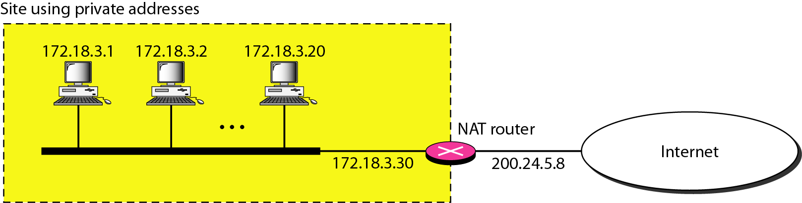
Simple NAT Configuration
Notes:
Here is the simplest NAT configuration. We have a router with a public IP address; and a network with a private IP address. The NAT device (which can be the router itself or a separate device) hides the entire 172.18 network from the world by making it appear to come from the 200.24.5.8 address. This is doing what it says on the box: Translating one set of IP addresses into another.

Slide 30
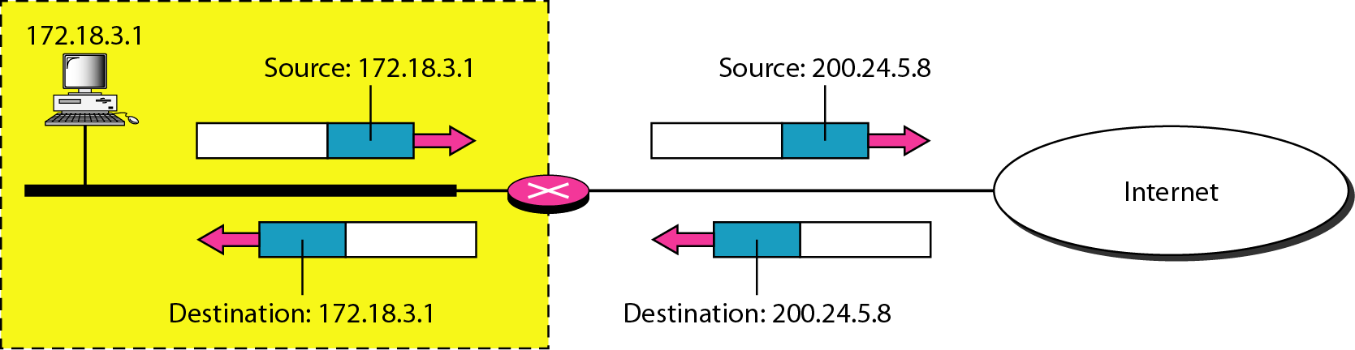
Simple NAT Configuration
Notes:
As a packet leaves the network it will have a source address in the 172.18 range. The destination doesn’t matter – it’s going somewhere on the Internet so the destination IP will be some random public IP address. As it crosses our NAT device we change the source address to our public IP – 200.24.5.8. Now the packet looks like it is coming from the NAT device. No-one knows any different.
When the reply packet comes, it will have a destination IP address of 200.24.5.8. Remember that reply packets have the source and destination IP addresses turned around. When it gets to the NAT device it remembers what it did earlier and it changes the destination from 200.24.5.8 back to the 172.18 address. It then sends the packet to the rightful recipient.

Slide 31
Dynamic Stateful NAT
Also known as “Hide NAT”
NAT keeps a table of active sessions
Maps many private IP address to a single public IP
Maps many private ports (by IP address) to many public ports (single IP)
Replies come to public IP address
Lookup in table to find appropriate private IP and port
Packet is rewritten and sent
Notes:
Unlike normal routing, NAT is stateful. It’s also dynamic – as sessions go in and out it remembers what is happening. We sometimes refer to this as a “hide” operation – because we’re hiding a whole network behind that one device.
[Click] The NAT router or device keeps a record of the active sessions that are currently going through it. It uses that table to map a bunch of private IP addresses to a single public IP address. And remember that we have a bunch of application ports too – things like HTTP on port 80 and SSH on port 22. So it has to map those as well.
[Click] When the replies come in the router does a lookup in the table for the right port number and that’s how it knows the private IP address.

Slide 32
Static Stateful NAT
“Hide” NAT doesn’t allow for new “inbound” sessions
Configure “static” port that is available to the Internet
Map to an internal IP address and port
They don’t have to be the same port – so 80 externally can map to 8080 internally
Notes:
There is another type of NAT – actually, there are lots of others but this is the one you’re likely to bump into.
[Click] The challenge with a “hide” NAT is that it only allows for connections in one direction – outbound from the private network to the outside world. What if you wanted to host a web server on your private network? How would you do that?
[Click] Turns out it is pretty easy. You configure a static NAT entry on the router – you tell it that if it receives connections for (say) port 80 (which is HTTP) that it should send it to an internal IP address. It works the same was as a dynamic entry but it doesn’t require something on the internal network to send the first packet. The other interesting thing is that you can change not just the IP address but also the port as it crosses the NAT router.

Slide 33
AWS Networking
Notes:
Ok. Lots of theory. Let’s talk about AWS stuff now.
33

Slide 34
AWS Networking
EC2 instances are launched into a Virtual Private Cloud (VPC)
Default VPC defines:
An address space (IPv4 and IPv6): 172.31.0.0/16 (65,536 addresses)
Subnet in each availability zone: e.g. 172.31.0.0/20 and 172.31.16.0/20
Internet Gateway
Main Route Table
Default Security Group
Default Network Access Control List (NACL)
Default DHCP settings
Notes:
First up: You already know what EC2 is, right? When you launch an instance you must attach it to a network and is your own Virtual Private Cloud – VPC.
[Click] In your accounts you’ll each have a default VPC that has been created. It has:
[Click] A standard address space allocated to it.
[Click] Subnets defined in two availability zones. Note that these are all really big networks. A /20 is 1,024 IP addresses which is way more than you’ll need. But that’s ok – it’s private so it doesn’t matter. In the real world you’d go smaller.
[Click] There is an Internet Gateway. This is used to connect your VPC to the rest of the world. If you don’t want to connect your VPC to the Internet you can delete this. For what you’re doing on this course, it’s essential. But in a corporate environment you might very well have VPCs that aren't connected to the Internet.
[Click] At the start you’ll have a single route table. This tells each subnet how to connect to other subnets; and to the Internet Gateway. It’s already done for you but you can create more route tables and customize your network a whole bunch if you want to.
[Click] There’s a default Security Group and NACL. We’ll talk more about those in a moment but you can modify these or create your own.
[Click] All instances get their IP addresses on your private network from a DHCP server – Dynamic Host Configuration Protocol. This is set up automatically as are some DHCP networking options to make your life easier.
So from the start, the VPC is set up and ready to go for you.

Slide 35
AWS Default VPC
Notes:
This is a diagram showing the various parts of your VPC.
Looking at the main route table: Note that there are two routes in it. The first says 172.31.0.0/16 is “local”. This means that all addresses in that space are local to the VPC and are reachable by instances in the VPC. This is a good default – you can change this and have different entries for each subnet if you want to. In that case, you might have a route of 172.31.16.0/20 for one subnet that does something a bit different.
You’ll also note that there is a default route – 0.0.0.0/0 going to the Internet Gateway – that’s the “igw” bit. All AWS resources have resource names and igw-anything tells us what it is. Anyway, the route tells the VPC that if the route isn’t found in 172.31.0.0/16 that it should go to the internet. The default route is more of a “catch-all” if there is nothing else that matches.
Also note that the diagram shows a router between the two subnets. Remember that routers connect networks together so this connects the two subnets and it uses the Internet Gateway as a router to connect to the outside world. In reality, there is no router at all. The VPC networking constructs do all the heavy lifting and they emulate routers. In the real world, routers are a thing but within the VPC they don’t really exist.

Slide 36
VPC Subnet
Attributes:
Name
VPC associated
Availability Zone
IPv4 CIDR block
IPv6 CIDR block (optional)
Notes:
Each subnet in your VPC has some attributes and these are pretty straightforward:
[Click] You can give it a name – this is handy because the subnet id we give it isn’t easy to remember for humans. And you might have a lot of subnets.
[Click] It belongs to a specific VPC.
[Click] It is hosted in a specific Availability Zone.
[Click] It has an IPv4 address range associated with it
[Click] And it can have an IPv6 address range associated with it too – you can use both at the same time if you wish

Slide 37
Network Security
Security Groups can be associated with a VPC but they act at the instance level
If a security group is not specified for an instance, it takes the default assigned to the VPC
Can have multiple security groups per instance
NACLs act on a subnet and have different characteristics than a security group
Notes:
There are two built-in network security tools you need to know about.
[Click] First is security groups. This is basically a firewall for each instance. You define the security groups within the VPC and then assign them to instances. You can have one security group that allows (say) HTTP or HTTPS to the instance; and then apply that to many instances.
[Click] Instances must have at least one security group. There is a default security group that you can use and customize. If you don’t specify a security group, the instance is automatically assigned the default security group.
[Click] You can assign more than one security group to an instance. That lets you do things like define a security group only for HTTP and then add it to an instance when you want that instance to receive web traffic. Of course, you could edit the security group assigned to the instance – there are multiple ways to do this.
[Click] Finally, there are NACLs – Network Access Control Lists. You apply these at a subnet level and they are good for large-scale filtering: For example, I want this network to talk to this other network. While you *can* use it to filter traffic between individual instances in my judgement you shouldn’t – use security groups for that.

Slide 38
Network Security
Notes:
This diagram shows the various parts of the VPC. Again, NACLs are applied and take effect at a subnet level– they are only active when traffic crosses between subnets. If you have two instances in the same subnet communicating with each other, NACLs don’t matter.
Security Groups are used at an instance level. You can filter traffic between two instances even if they are on the same subnet. In my opinion, security groups are a better option in almost all cases. I've seen customers tie themselves in knots because they define really restrictive NACLs and then forget that they did that. Later on, things don't work as expected.

Slide 39
Security Groups vs NACLs
Security Group | Network ACL
Operates at the instance level (first layer of defense) | Operates at the subnet level (second layer of defense)
Notes:
Let’s compare Security Groups and NACLs.
We’ve already covered this – instance and subnet level controls.

Slide 40
Security Groups vs NACLs
Security Group | Network ACL
Operates at the instance level (first layer of defense) | Operates at the subnet level (second layer of defense)
Supports allow rules only | Supports allow and deny rules
Notes:
Security Groups have rules that allow traffic. If it isn’t allowed then it is denied. NACLs have rules that allow traffic and rules that deny traffic. Sometimes it’s useful to have that level of flexibility.

Slide 41
Security Groups vs NACLs
Security Group | Network ACL
Operates at the instance level (first layer of defense) | Operates at the subnet level (second layer of defense)
Supports allow rules only | Supports allow and deny rules
Is stateful: Return traffic is automatically allowed, regardless of any rules | Is stateless: Return traffic must be explicitly allowed
Notes:
Security Groups are stateful like a firewall. If you specify that certain traffic is allowed then the response to that traffic is automatically allowed.
NACLs are different. They are stateless – you must allow traffic in both directions. It means you have to have a very specific and detailed idea of the traffic patterns. This makes configuring NACLs for fine control very difficult. Again, easy to block access to a whole network. Very tricky to say “only allow this protocol or application”.

Slide 42
Security Groups vs NACLs
Security Group | Network ACL
Operates at the instance level (first layer of defense) | Operates at the subnet level (second layer of defense)
Supports allow rules only | Supports allow and deny rules
Is stateful: Return traffic is automatically allowed, regardless of any rules | Is stateless: Return traffic must be explicitly allowed
All rules are evaluated before deciding to allow traffic | We process rules in order when deciding to allow or deny traffic
Notes:
With Security Groups, we look through all the rules to find something that allows traffic. If we don’t find it, then we deny that traffic.
With NACLs, the rules are processed in order. So if you block something on rule 3 then allow it on rule 5 it will get dropped even though there is an allow rule.

Slide 43
Security Groups vs NACLs
Security Group | Network ACL
Operates at the instance level (first layer of defense) | Operates at the subnet level (second layer of defense)
Supports allow rules only | Supports allow and deny rules
Is stateful: Return traffic is automatically allowed, regardless of any rules | Is stateless: Return traffic must be explicitly allowed
All rules are evaluated before deciding to allow traffic | We process rules in order when deciding to allow or deny traffic
Specific to the instance it is assigned to | Automatically applies to all traffic in the subnet it is assigned to; therefore applies to all instances in that subnet
Notes:
Security Groups are specific to the instance or instances that it is assigned to.
NACLs are applied at a network level – where traffic crosses into the subnet; and apply to everything in that subnet.

Slide 44
NAT Gateway
Used to create a private subnet
NAT Gateway needs to be part of a public subnet
Is allocated an Elastic (public) IP
Private subnet has a custom route table that points all default traffic to the NAT Gateway
NAT Gateways can only be used for “Hide NAT”
Cannot map “inbound” ports – but use a load balancer!
Notes:
Earlier we were talking about Network Address Translation. Given that your VPC runs a private network you’re going to need something that does NAT – and luckily we have a service for that.
[Click] NAT Gateways let you have subnets that have no direct connectivity to the Internet.
[Click] You put the NAT Gateway in a public subnet – you already have two of those in your VPC – they’re created by default. The NAT Gateway is assigned a public IP address – we call this an Elastic IP because – you know – everything in AWS has an “elastic” something in the name.
[Click] In the private subnet you route all internet traffic (that’s the default route) to the NAT Gateway. And then it does NAT.
[Click] NAT Gateways can only be used for “hide” NAT operations. But that’s ok – because if you want inbound connections; like hosting a web server; you’d use a load balancer. And we’ll talk about those in a minute.

Slide 45
NAT Gateway
Notes:
For reference – here’s a diagram showing the NAT Gateway. Note that this VPC uses the 10 network – that’s ok; it’s also a private network. And note that we have two different route tables – one for the private subnet; one for the public subnet.

Slide 46
Load Balancing
Notes:
Last topic, I promise – load balancing. Phew!

Slide 47
Load Balancing
Load balancers do exactly what they say on the box – load balance
Different types of Load Balancer in AWS:
Application Load Balancer (ALB)
Acts at Layer 7 of the OSI model
HTTP/HTTPS for most people
Network Load Balancer (NLB)
Acts at Layer 4 of the OSI model
TCP for most people
Gateway Load Balancer (GWLB)
For inspection of traffic using firewalls
Notes:
The short version of this is pretty easy: Load balancers do what they say they do: They load balance. What does that actually mean? Well, if you have a single web server then you have a problem. What happens if lots of people try and use it at the same time? It might get overloaded. So you get a bigger web server, right? But that costs more money and if there is less traffic then you’re wasting money. What happens if the web sever dies suddenly? The hardware fails. The software fails. Something fails. Now you have no web server. That’s bad.
Ideally what you want to do is to be able to scale your web server up and down as required and to fix itself. Rather than make it bigger or smaller – why not add more web servers and then remove them when you don’t need them. That’s neat. And it’s cost effective. But if you’ve got multiple web servers how do you spread the load across them? And there we are. Load balancers.
[Click] A few different types in AWS: [Click] Application Load Balancer or ALB – used for web traffic; probably the one you want. [Click] Network Load Balancer for other types of traffic. [Click] And Gateway Load Balancer which is for inspecting traffic at scale. Mostly used by enterprise customers.

Slide 48
Application Load Balancer
You’ll use this for websites
HTTP/HTTPS is the underlying protocol
Requests are:
Received by a Listener
Distributed according to a configurable algorithm (Rule)
Rules consist of actions and conditions
Sent to a destination (an instance in a Target Group)
Each Rule specifies a Target Group, Condition and Priority
Only ”healthy” instances are used
Can configure “sticky” sessions
Notes:
So let’s dive a little into ALB. As per the previous slide, use this for websites. Mostly. [Click] And that means HTTP and HTTPS.
[Click] Each request has a path that it goes through:
[Click] There is a listener – this is the protocol and port that the load balancer is waiting for people to connect on. So you’d select HTTP on port 443 for example.
[Click] You must have one rule but you can have more if you like.
[Click] Actions can be forward (that is, send it to a real web server that you are hosting on an instance), redirect somewhere else or respond directly. Conditions let you act on headers, source IP addresses or a part of the URL path.
[Click] If you choose to forward then the traffic is sent to an instance – a web server. Instances generally belong in a target group. You can have many target groups; but you’ll probably only have one for starters – and all traffic will be distributed across all instances in that target group.
[Click] Rules have all these things and a priority. So that you can specify what gets done first.
[Click] The ALB performs health checks on all the instances and if an instance is unhealthy – it isn’t responding correctly – then we stop sending traffic to it.
[Click] Finally, your application might require a user (in their web browser) to always go to the same server. This is called a “sticky” session. You can configure this on the load balancer. If you can design your application so that it doesn’t need sticky sessions that’s a far better way to be. Because what happens if the user has a sticky session to a web server and then it goes unhealthy? They lose their information because it is presumably only on that one server.

Slide 49
Application Load Balancer
Notes:
This is a simple diagram showing the components I’ve described. Here we have multiple listeners, multiple rules, multiple target groups. Pretty much what you’d expect.

Slide 50
Load Balancing
Allows horizontal scale
Greater demand, add more instances
Less demand, remove instances
Allows for update of code on instances without interrupting service
Can handle termination of SSL/TLS
Less load on instances
Simpler code on instances
Adds a layer of security
Instances are not directly accessible from the Internet
Notes:
So some more information for you:
[Click] The whole point here is that you can scale your servers in and (more importantly) out. Remember that you save money in AWS by turning things off. Rather than do this manually, you can create an auto-scaling group. This tracks the performance and health of the instances; automatically registers new instances with the load balancer; and will scale up and down as you require. Normally you’d do it on CPU usage on the servers but you can choose other metrics.
[Click] This means if you want to deploy new code you can do it without taking all of your instance offline. You can replace them gradually.
[Click] Because HTTPS is secure it can create some challenges for you. You need to distribute certificates and do a bunch of work on the web server to decrypt things. Instead, why not get the load balancer to do that for you?
[Click] And finally, this means that your instances aren’t visible on the Internet. Only the load balancer is. The servers can communicate with each other; they can talk privately to other systems such as databases; but nothing on the Internet can directly communicate with the servers – they have to go through the load balancer; and it only allows valid HTTP requests to come through. If it’s anything else, it gets dropped and the servers don’t see it.

Slide 51
Application Load Balancer at Work
1
Web
Availability Zone A
HTTP Request
GET /index.html
ALB
1
2
2
Web
Availability Zone B
Auto-scaling
Target Group
Notes:
A quick animation to show how this works.
[Click] Here’s our ALB and [Click] these are our web servers that are registered with the ALB. [Click] These are part of an auto-scaling group. [Click] And we really want to to put the servers in multiple availability zones. The auto-scaling system does this for you automatically if you select multiple AZs so it’s quite easy to do.
[Click] Here’s our HTTP request. Let’s call it request number 1. After careful deliberation, [Click] the ALB sends it to a server where it is being process.
[Click] A second request comes in. The ALB knows that the first request is still happening so [Click] it sends this one to another web server.
It really is as simple as that. Until it gets complicated, of course…

Slide 52
Application Load Balancer at Work
An instance can be “drained” of connections and taken offline
EC2
LB
EC2
Notes:
Why might we have to take an instance offline?
First, it might be unhealthy. It’s failed in some way and isn’t accepting connections any more. That could be a software problem. It could be a hardware problem. Doesn’t matter at all – it’s a failure of some sort.
Second, you might decide that you want to upgrade the software on the instance. The best way to do that is to take it out of service. Now I might say again here that we believe in cattle rather than pets. What you should be doing is having a “gold” image for your application. Something that is easily deployed and is the same across all of the instances that are in the target group. You should be doing maintenance or upgrading the software on the gold image and then taking an existing instance out of service and having the auto-scaling group replace the instance with a new one from the gold image.
Third, we might have to update hardware or move things around. It’s rare and it falls under the “failure” mode above.
[Click] Anyway. Here is our load balancer, target group (hopefully autoscaling!) and a failed EC2 instance. That’s the red one.

Slide 53
Application Load Balancer at Work
An instance can be “drained” of connections and taken offline
EC2
LB
EC2
Notes:
First, the load balancer waits until all the connections to the failed instance have completed. It might not be accepting new requests (that’s how we do the health check) but it might still be finishing up with existing requests so we wait. All new requests go to the other EC2 instances in the group.

Slide 54
Application Load Balancer at Work
An instance can be “drained” of connections and taken offline
EC2
LB
Notes:
Once everything is drained we terminate the instance. I’m using that word specifically because in our world, “terminate” means: kill it. Delete it. Stop it and delete all the data. Again, we’re dealing with cattle rather than pets here.

Slide 55
Application Load Balancer at Work
An instance can be “drained” of connections and taken offline
EC2
LB
EC2
Notes:
Next we start a new, nice, working instance. That’s the green one. Once it has started and the health checks say it is ready to go…

Slide 56
Application Load Balancer at Work
An instance can be “drained” of connections and taken offline
EC2
LB
EC2
Notes:
…we start sending requests to it.

Slide 57

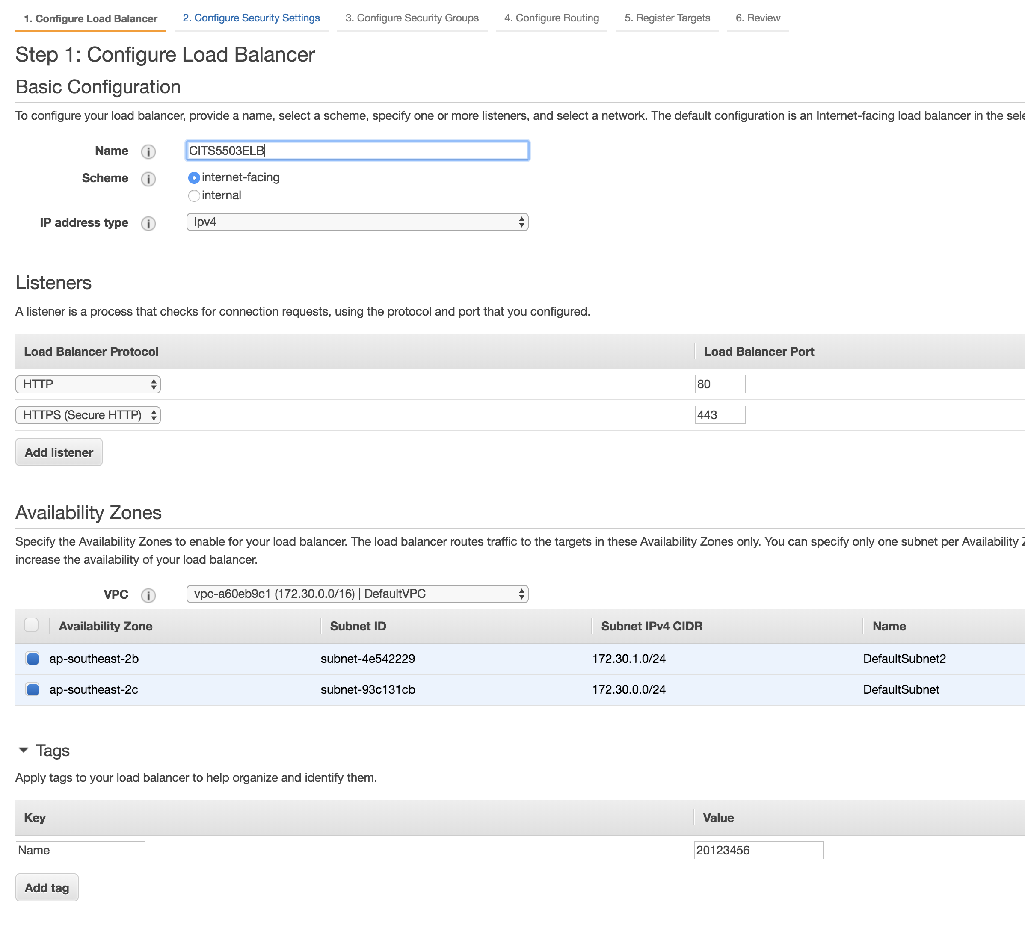
Setting up an Application Load Balancer
57
Notes:
Here are some screenshots on how to set up an ALB.
You can see that the console is asking for details we’ve already talked about – Listeners, Availability Zones and so on.

Slide 58
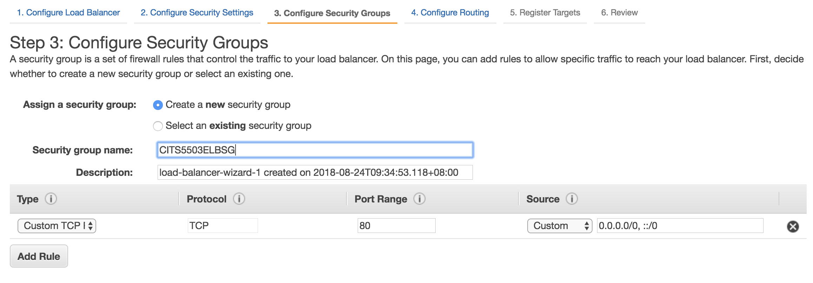
Configure Security Group
Notes:
You’ll also need to configure a Security Group. This allows traffic from the outside world to the ALB. Here you can see that this is going to receive traffic on TCP port 80 (which we know is HTTP) and the source is everywhere – that’s what the 0.0.0.0/0 means. Note that there are lots of helpers built in here. You can just select “HTTP” in the Type select on the left and it will fill things in for you. Similarly, in the Source select you can choose from a list of standard options.

Slide 59
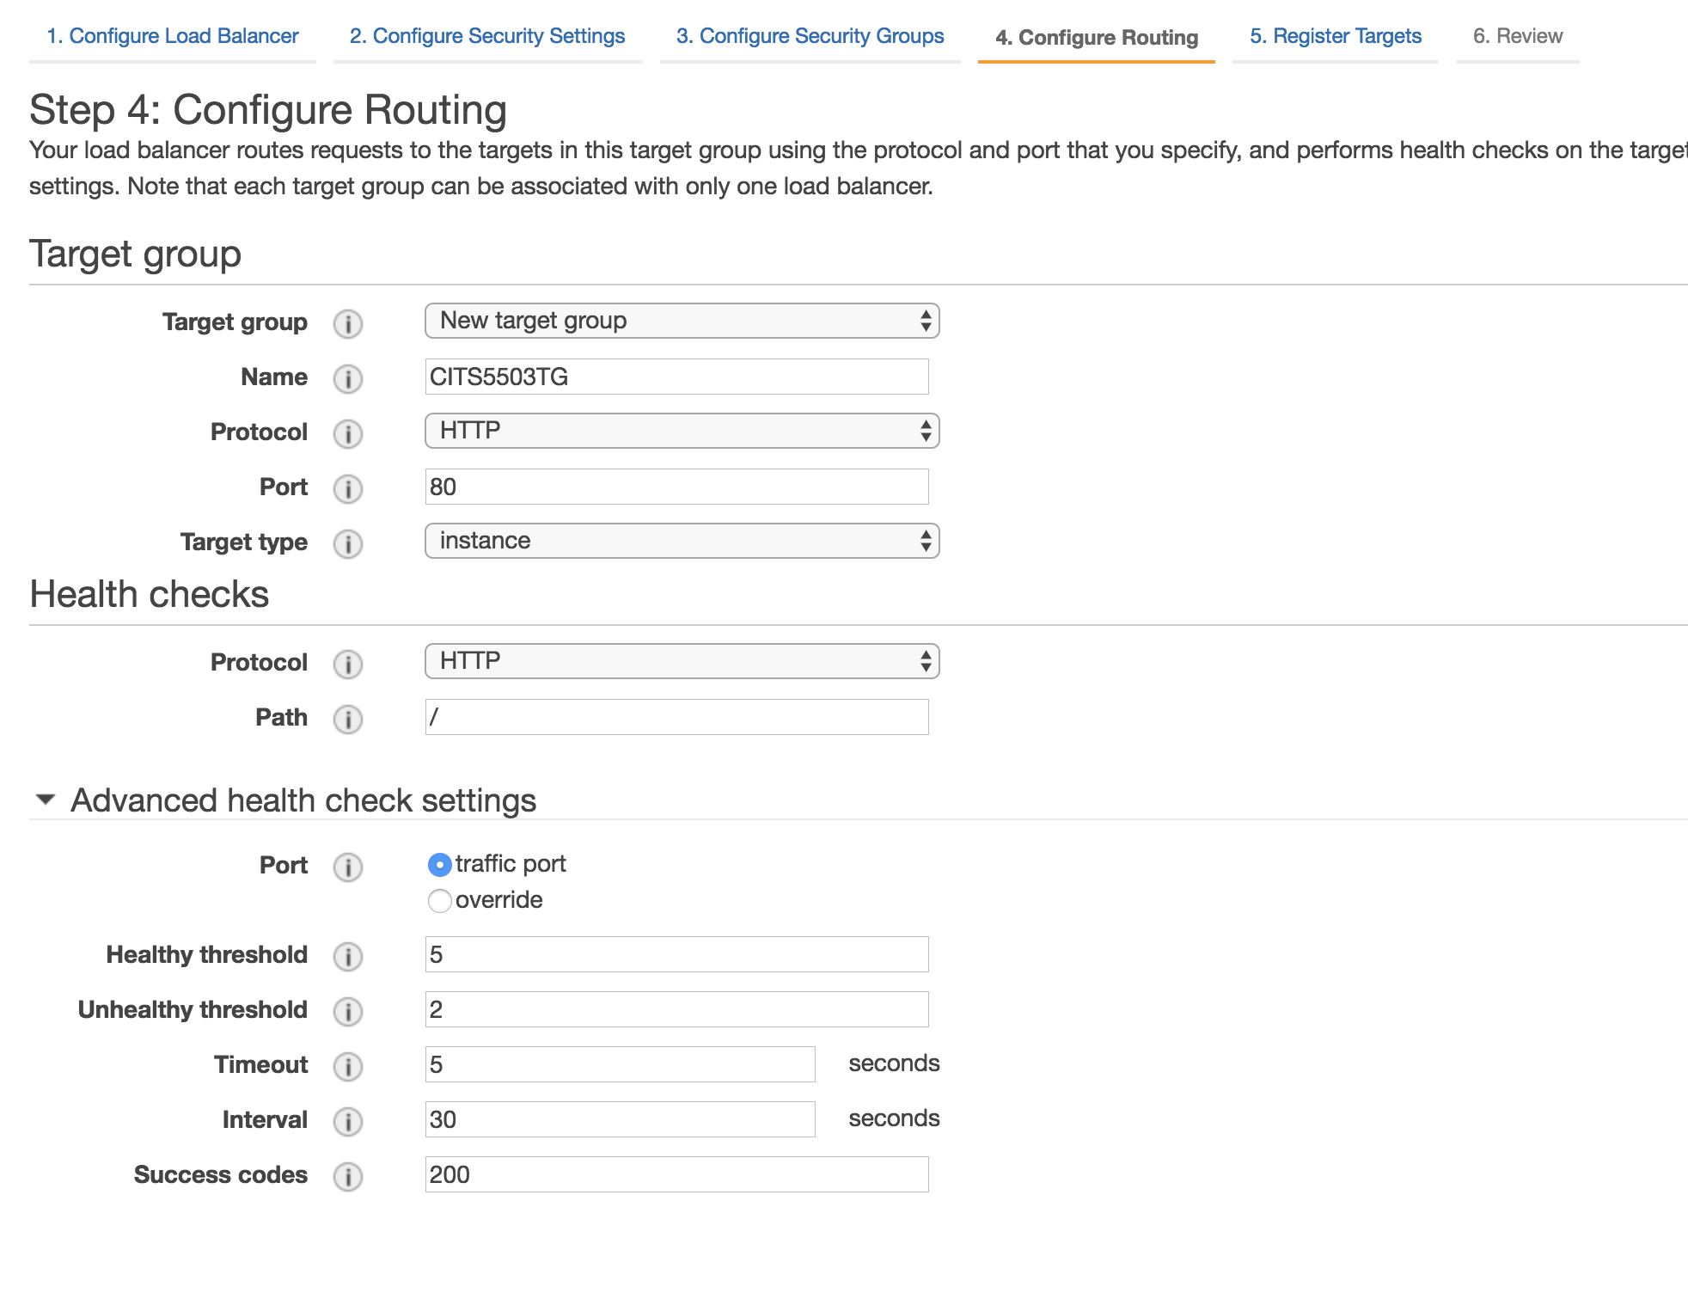
Target Group
Notes:
Here we’re configuring the target group and health checks. Normally you can leave these at the defaults and you’ll be fine.

Slide 60
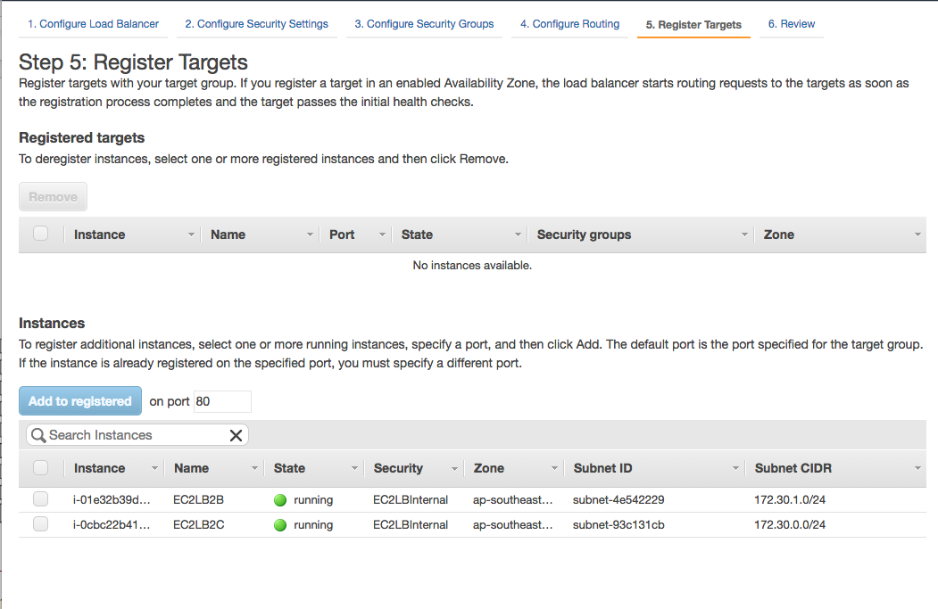
Register Targets
Notes:
If you have existing instances you can register them manually with the ALB. In the real world, with auto-scaling it all happens for you.

Slide 61
Questions?
brettski@amazon.com
Notes:
Phew. Wow. What a tour! What questions do you have?

